Slide 1
Micro-Enterprise Grant Winners
November 15, 2018

Slide 2
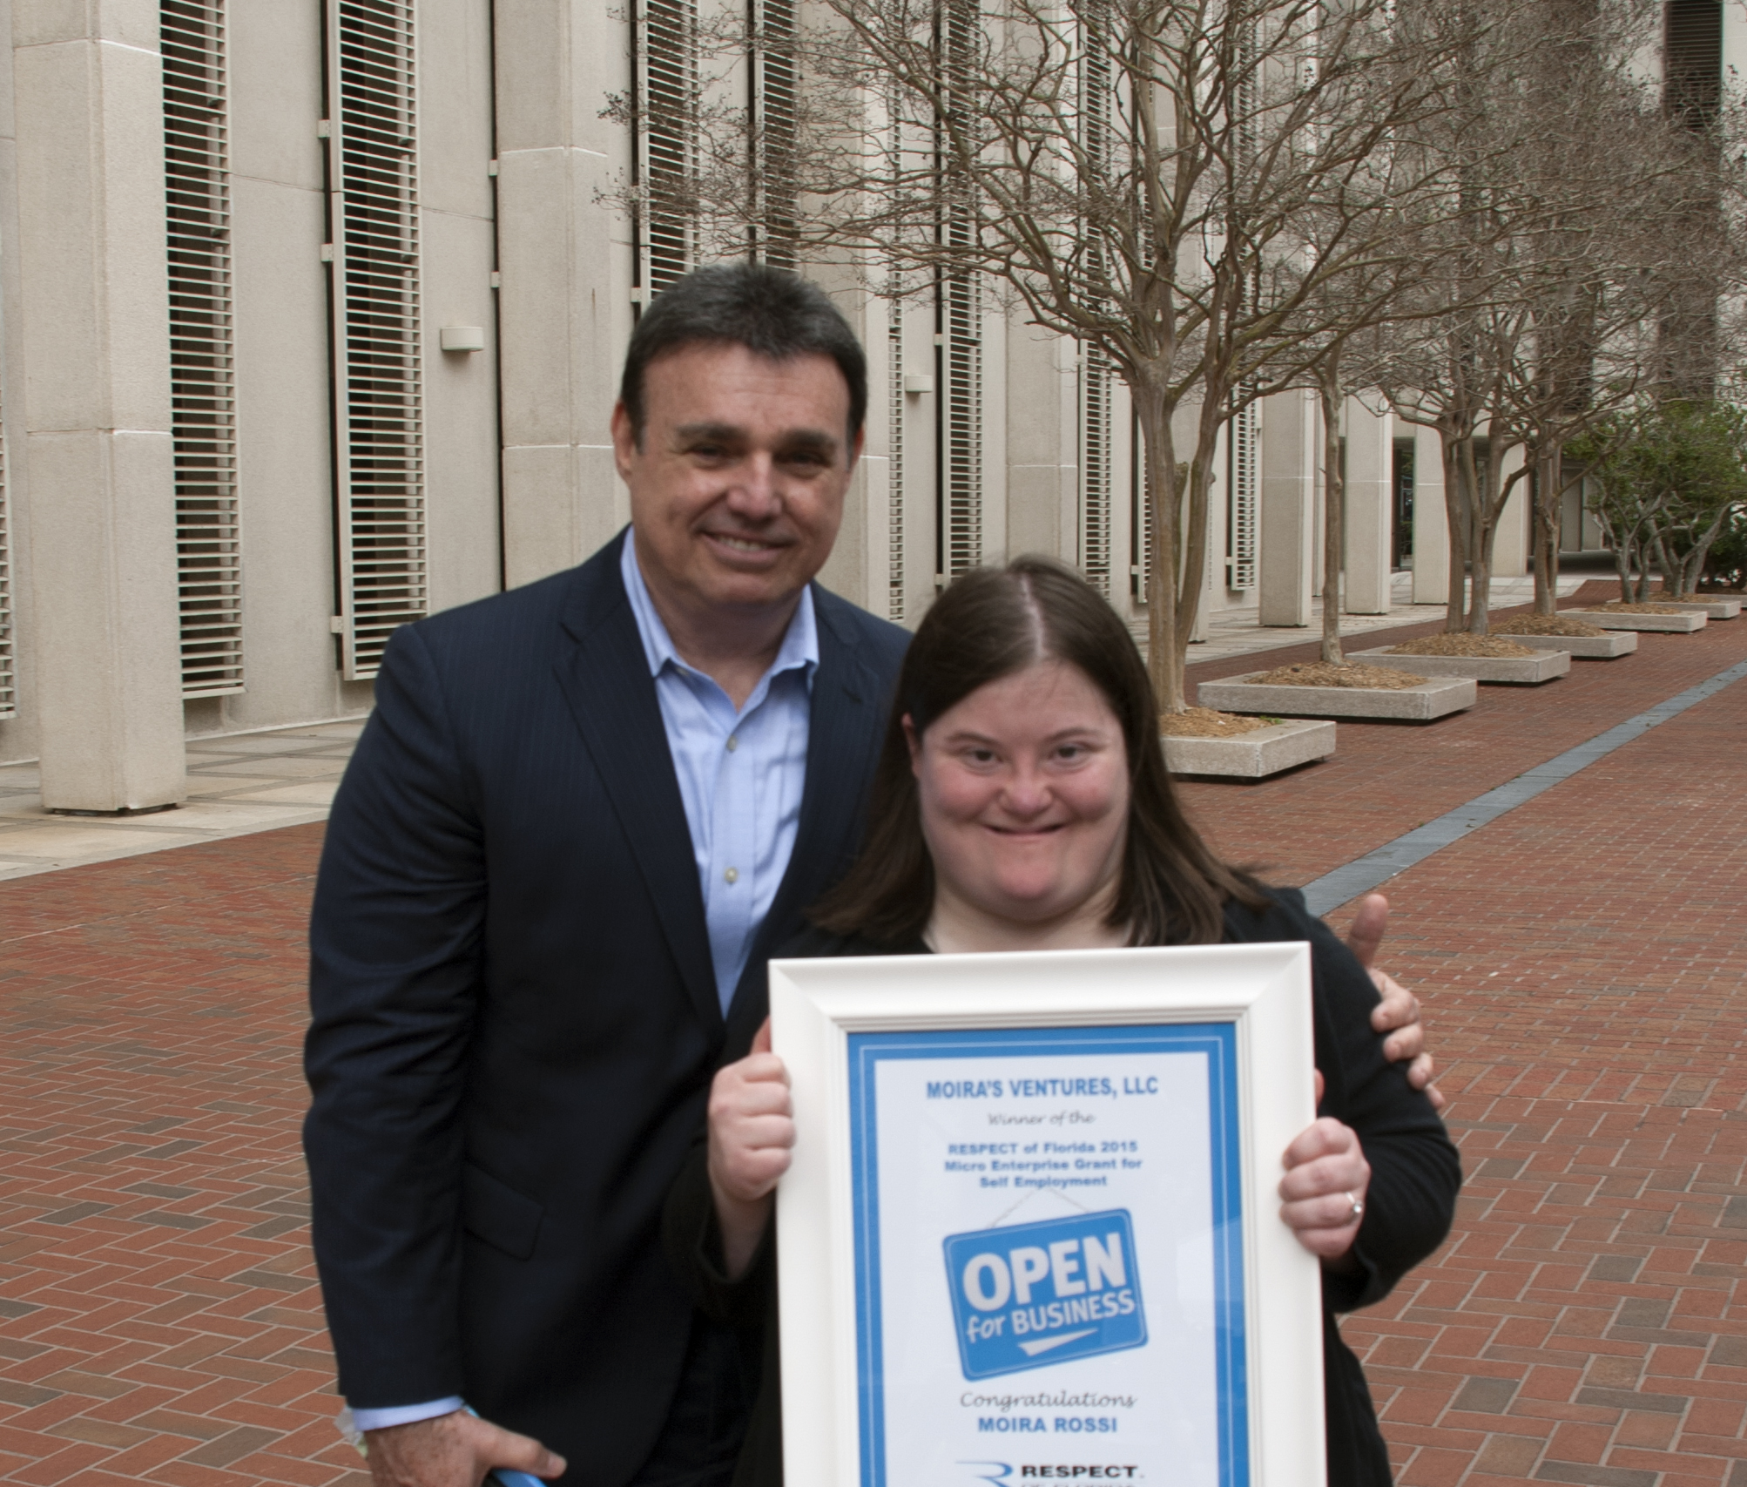
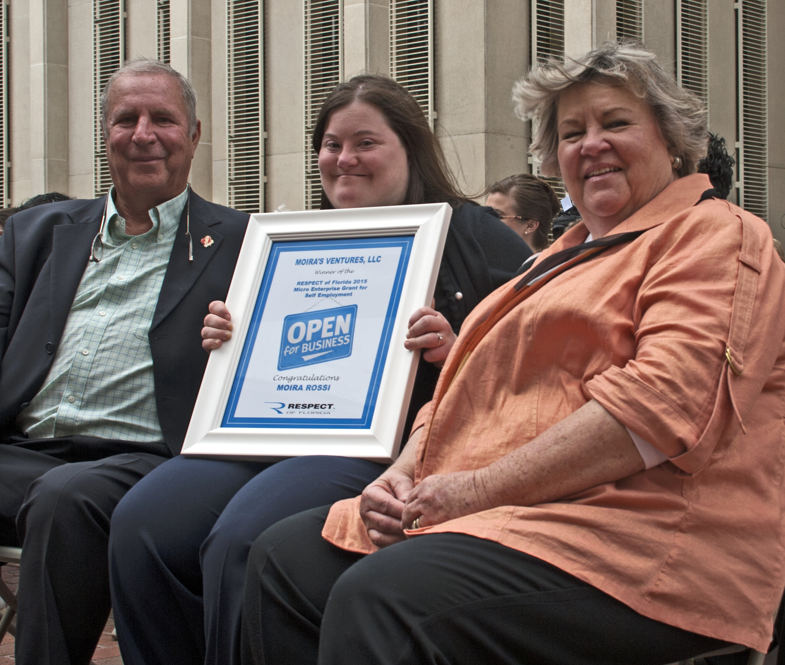
Moira’s Ventures
Moira Rossi, 2015 Grant Recipient
Self-Advocacy and Public Speaking
Creates self-help videos for others to become self-advocates
Produces DVDs and workbooks for purchase
Presented at Family Café 2016
Hosted Family Café conference booth 2018

Slide 3
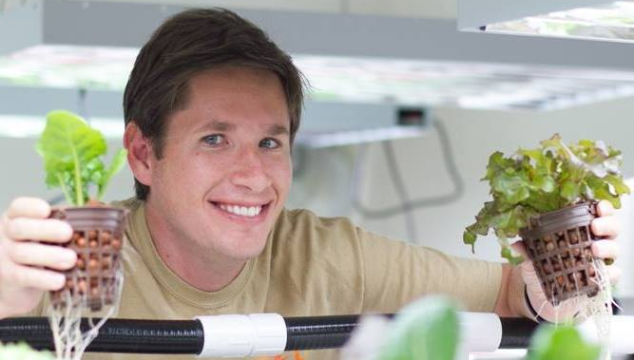
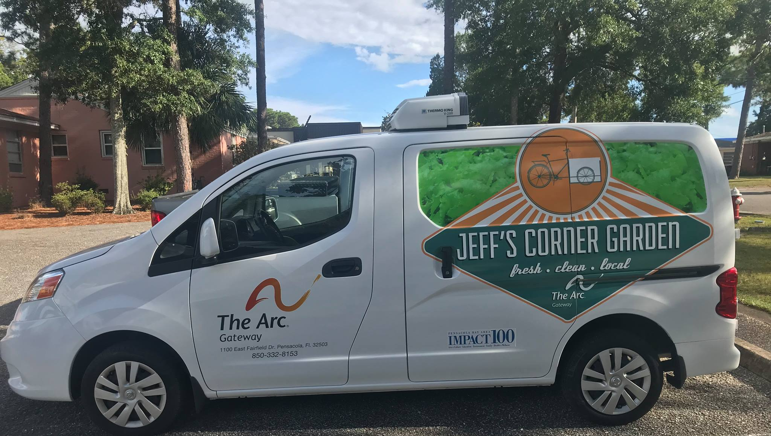
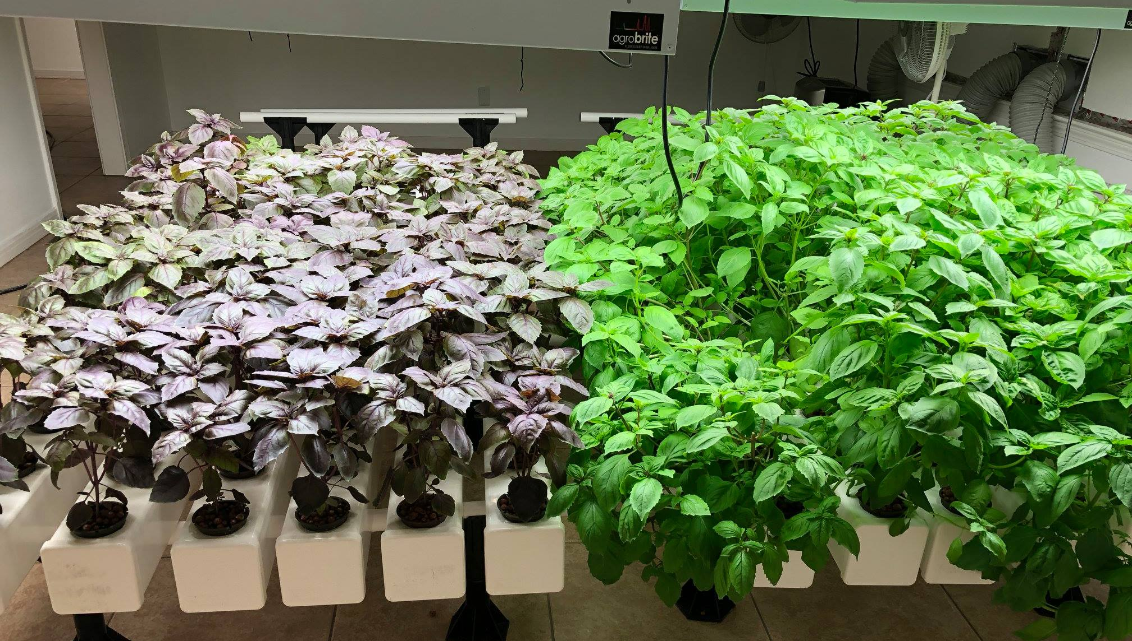
Jeff’s Corner Garden
Jeff Shell, 2015 Grant Recipient
Garden started in a corner of a community garden
Jeff used a refrigerated bicycle cart to deliver produce to local restaurants
Quickly grew and opened a second garden location
Operation now located at Arc Gateway as an indoor, hydroponic garden (made possible by another grant he received)
Acquired a delivery van
Helps others with disabilities get hands-on training and valuable job skills

Slide 4
Oceanspray Photography
Thaddeus Wilkins, 2016 Grant Recipient
Photography and Videography Services
Used grant funds to purchase new equipment
Recently moved to Omaha, Nebraska
Still operates photography business in Nebraska

Slide 5
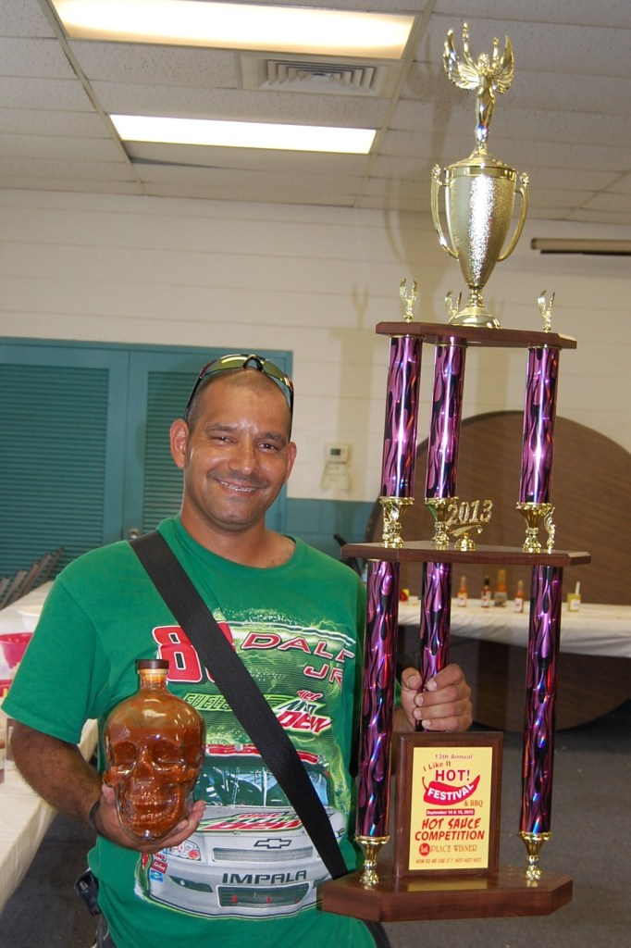
Ybor Eddie’s Hot Sauce
Eddie Rodriguez, 2017 Grant Recipient
Formally created business and registered “Ybor Eddie’s Hot Sauce” as a fictitious name
Purchased equipment and internet. Setup social media and website store front
Created 300+ bottles of inventory
Conducted an in-house sampling party
Sells at local restaurant Gaspar’s Grotto and online
Hired graphic artist to create professional labels and artwork for his brand
Seeking USDA approval on nutrition labels to expand to new vendors

Slide 6
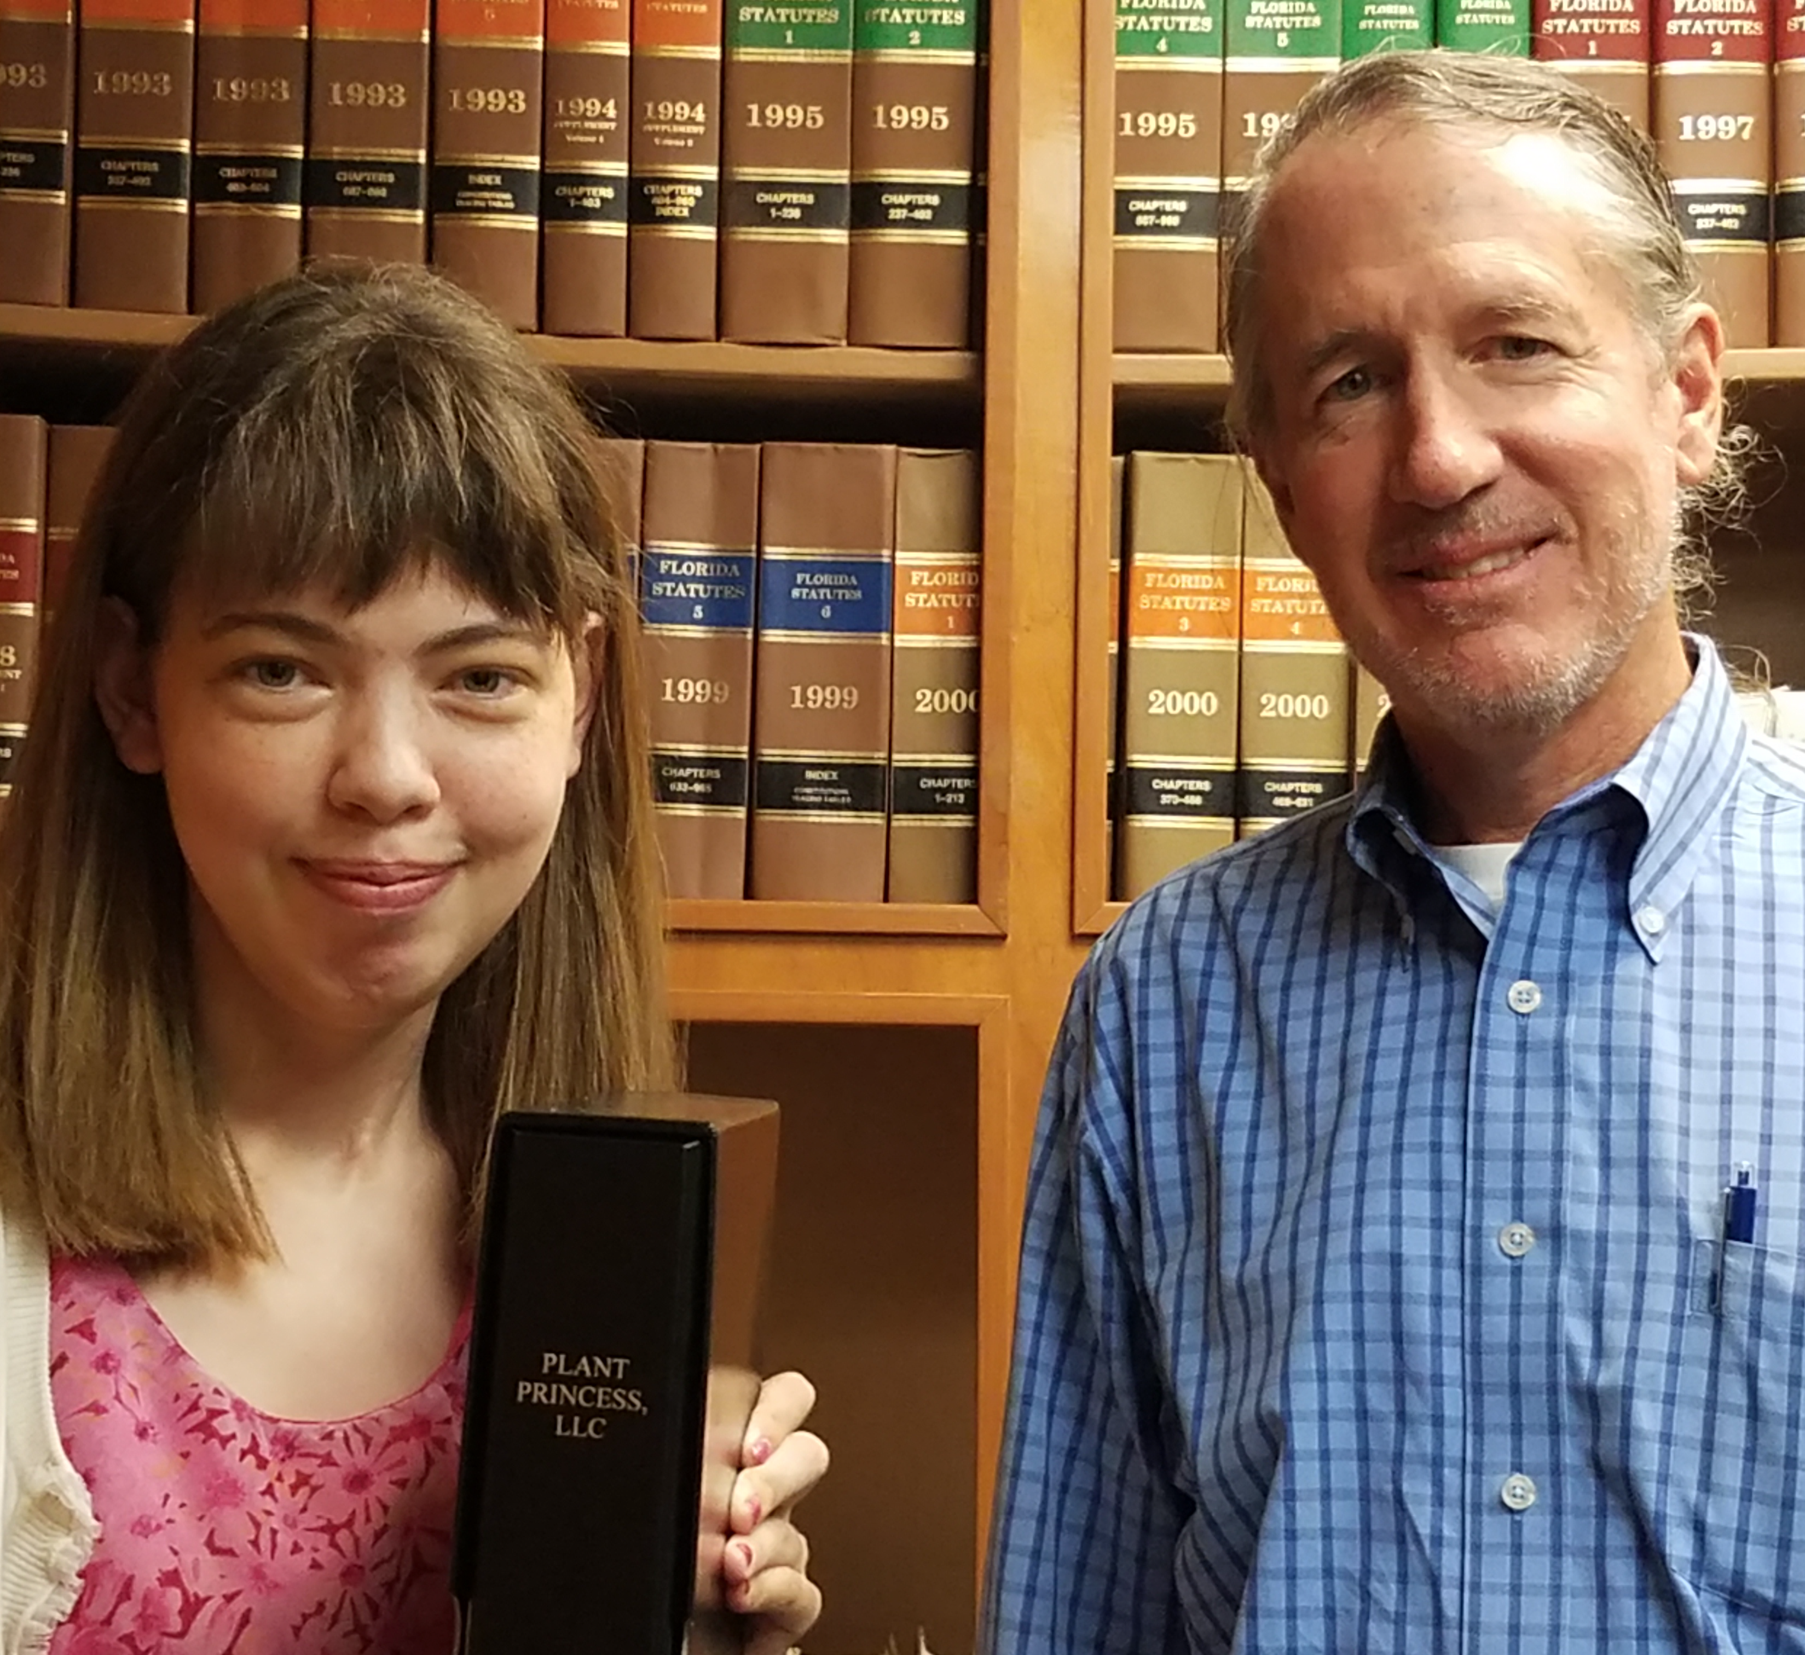
The Plant Princess
Tiffany Roper, 2017 Grant Recipient
Offers a variety of services including:
Plant Care and Maintenance
Floral Displays
Plant setup and/or rental
Officially established business in June 2018
Next steps include purchasing tools and equipment and investing in marketing

Slide 7
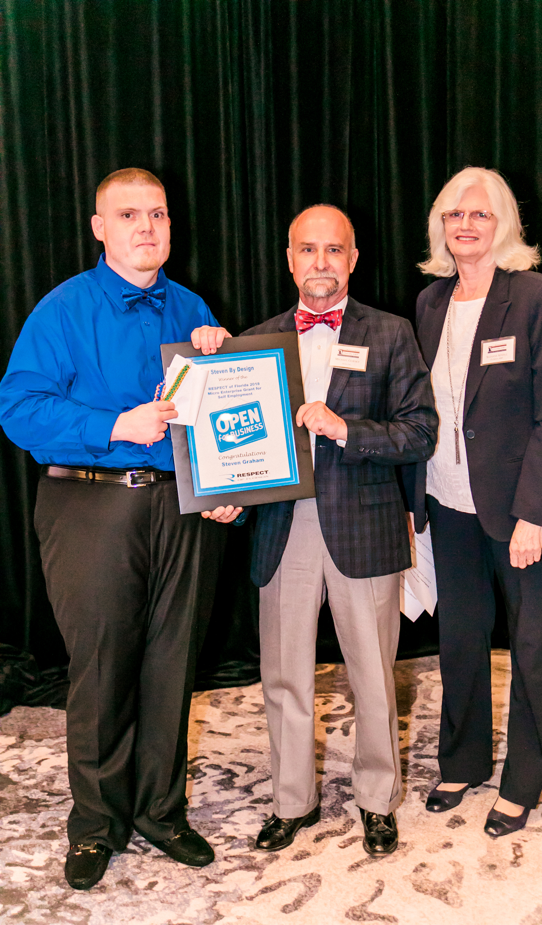
Steven By Design
Steven Graham, 2018 Grant Recipient
Creates paracord bracelets
Award Grant in August
First Reporting due in December

